Slide 1


Slide 2
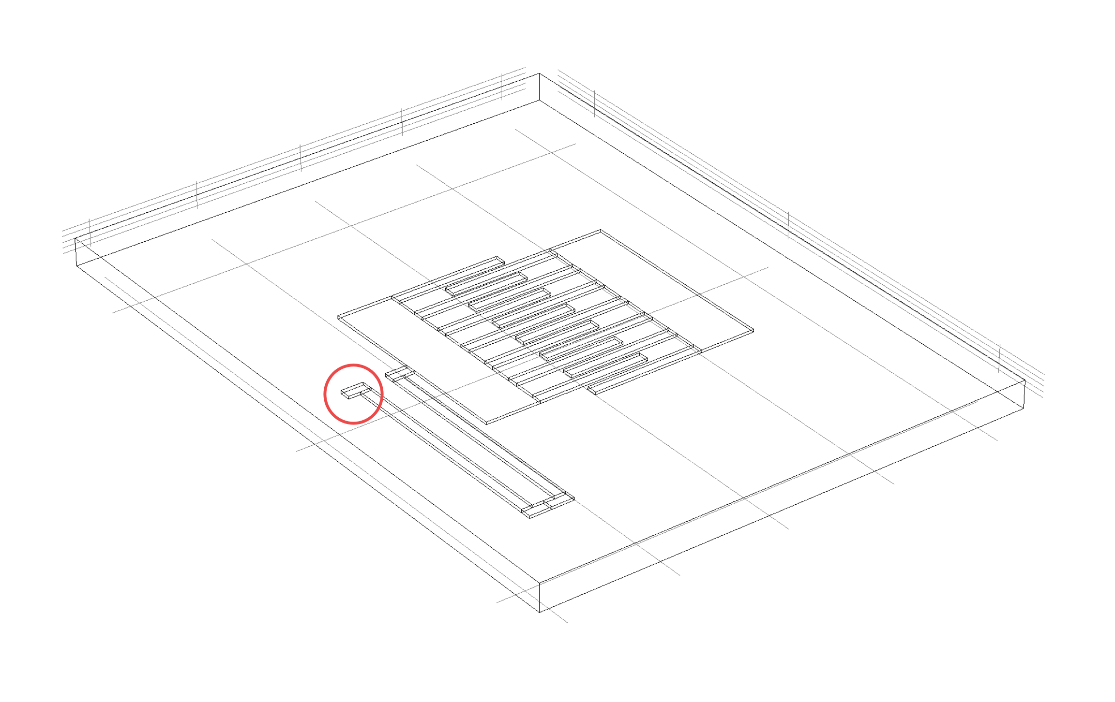
Air Box
Thickness

Slide 4



Slide 5
freq(a)=2000Hz
freq(b)=3000Hz
(a)
(b)
freq(c)=4000Hz
freq(d)=5000Hz
(c)
(d)

Slide 6











$w_{st}$
Finger
0.5 $g_{f}$
$g_{f}$
$w_{sp}$
$w_{sp}$
$l_{st}$
$l_{sp}$
$w_{f}$
$l_{f}$
Stator
Spring
y
Material:
Copper
2$×w_{sp}$
x

Slide 7
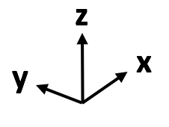
Air Box
Thickness

Slide 8
z
y
y
x

Slide 9

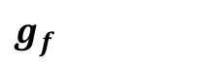
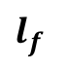
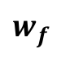
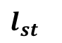
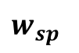
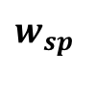
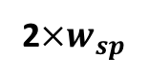
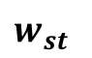
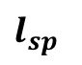
$l_{st}$
Finger
0.5 $g_{f}$
$g_{f}$
$w_{sp}$
$w_{sp}$
$w_{st}$
$l_{sp}$
$w_{f}$
$l_{f}$
Stator
Spring
y
Material:
Copper
2$×w_{sp}$
x

